Slide 1
Valencia’s AHA Promotion Programme
Preventing Frailty in post-menopausal women

Slide 2
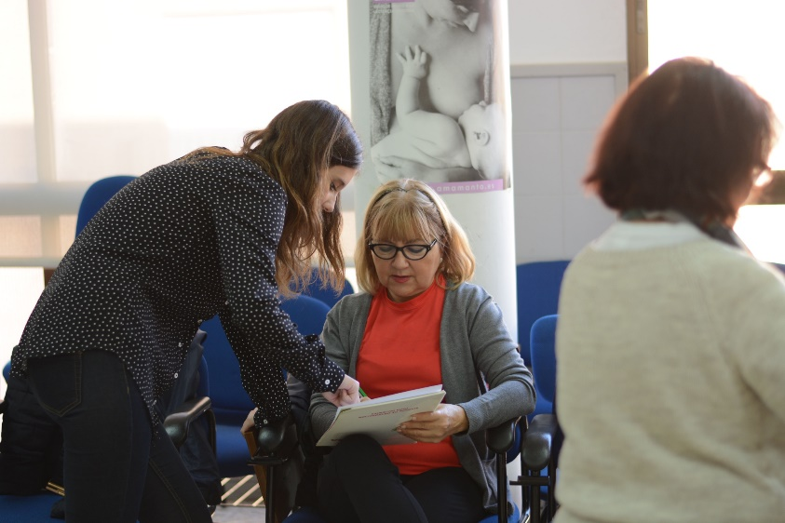
Phases of the programme

Slide 3
Sustainability and scalability http://salusvitae.es
ICT
WEB SITE
(SALUS VITAE)
SOCIAL MEDIA-SUPPORTED GROUPS (VIRTUAL GROUPS)
FIGHTING ICT ILLITERACY (COURSES)
FIGHTING HEALTH ILLITERACY (TALKS PROGRAMMES)

Slide 4
More information
http://focus-aha.eu/home
http://salusvitae.es
Ph. D. Antonio Cano
FOCUS Project Coordinator
Antonio.Cano@uv.es
Eva-Amparo Jaime
Project Manager
Eva.Jaime@uv.es

