Slide 1
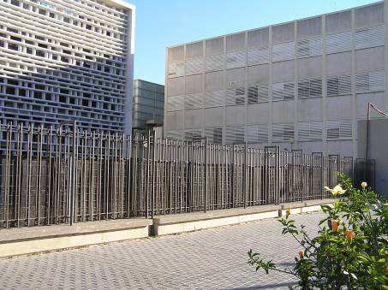
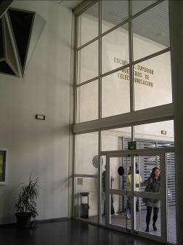
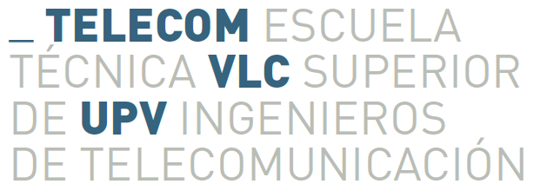
Grado en Ingeniería de Tecnologías y Servicios de Telecomunicación
Design and Development of a Pervasive Monitoring System based on Arduino Smart Home Kit and Smartwatches
Author: Weisi Han
Supervisor: Vicente Traver
Valencia, 03/05/2017

Slide 2
The Objective of the Project
To design a comprehensive monitoring platform based on Arduino Smart Home Sensor Kit and e-Health Sensor Kit
Arduino
Software
Sensors
Display Interfaces
Notes:
Collect environmental and biometric data from sensors
Send commands to control the sensors
Use an attractive and visual approach to display the sensor data in different interfaces
The system will be deployed in two different scenarios: : 1) Desktop Computer with Windows 10 Operating System and 2) Raspberry Pi with Windows 10 IoT Core Operating System.

Slide 3
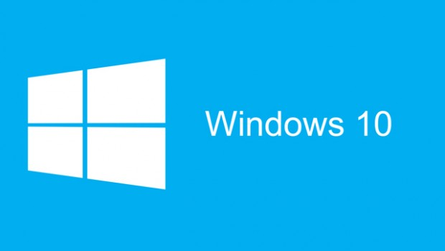
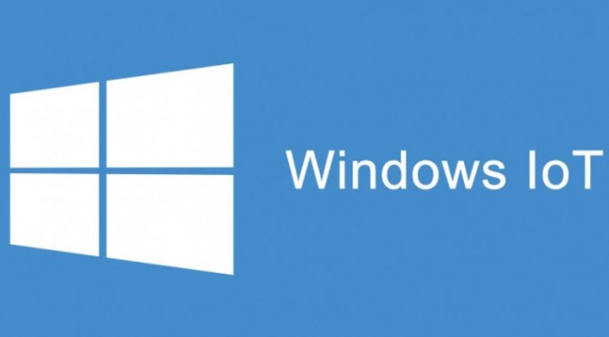
System Deployment
Desktop Computer
Windows 10 OS
Raspberry Pi3
Windows 10 IOT Core OS
Notes:
the overall deployment has been configured in two different deployment scenarios: 1) Desktop Computer with Windows 10 Operating System and 2) Raspberry Pi with Windows 10 IoT Core Operating System. The same functionalities for requesting and retrieving data from sensors and hosting a web page were embedded into the two systems.

Slide 4
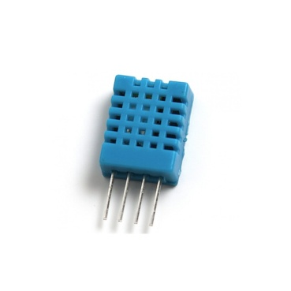
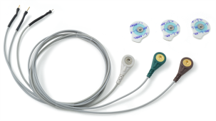
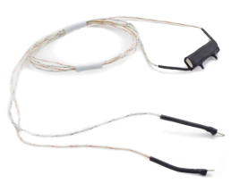
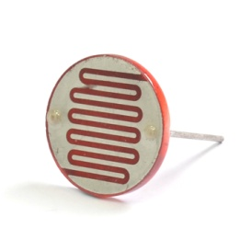
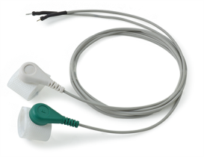
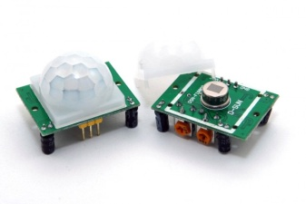
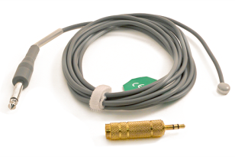
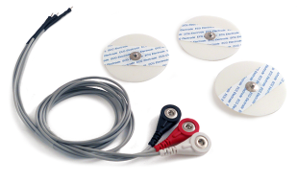
Sensor Selection
EMG sensor
Temperatur Humidity sensor
Airflow sensor
Photosensitive Resistance
GSR sensor
Motion sensor
ECG sensor
Body Temperature sensor
Notes:
After understanding the basic function of each sensor and their usage scenarios, I divided my system into two parts -- environmental information detection part and biometrical information detection part. The biometric sensors include:.... and the environmental sensors are:....

Slide 5
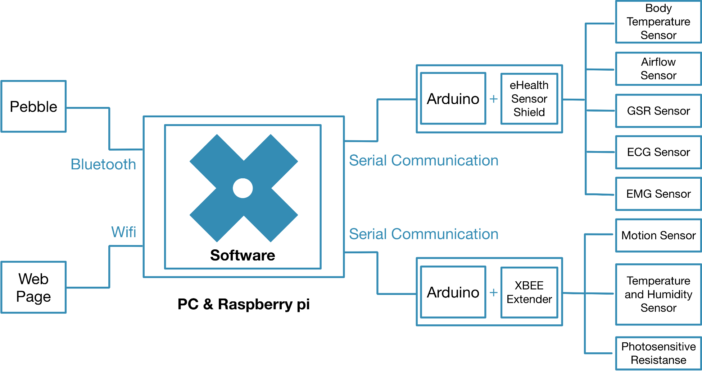
Architecture of the Whole System
Notes:
Here is the system architecture. On one side of the system, all of the five biometric sensors would be integrated on one Arduino board to detect and collect biometric information at the same time. Three environment sensors would be integrated on another Arduino board, and these sensors can run concurrently as well. On the other side of the system, different elements would be used to display the collected data (pebble watch and web page). As for the communication between the web page and the Arduino boards, a software which uses the choreography engine has to be developed. This software would be connected to the display interfaces by using Wi-Fi and communicate with the Arduino board through serial communication. The software should be deployed in pc platform as the first step, and then ported to the raspberry pi win 10 IOT core platform. In terms of the pebble watch, it must be connected to the Raspberry pi via Bluetooth so that further communications can be ensured.

Slide 6
Difficulties
Sending text to the Pebble
Bluetooth Communication
Notes:
During the process of my implementation. I encountered some difficulties in my project. The first difficulty is about sending text to the pebble. The idea is to connect the pebble with the Raspberry pi so that the software deployed in the pi can send data to the pebble via Bluetooth. During the previous weeks, we tried our best to use code to first pair the device, the connect it with the raspberry pi, and after that, ping the watch. All of the above steps have succeeded. But when it comes to sending text, it failed. We know the we need to use a special message to send the text, but we tried every possibility but none of them works. So in the next week we can try other solutions.
The other problem is that, in both deployment scenarios, the Arduino boards were connected to the choreography engine by the USB. Although this kind of wired communication provides a relatively stable and reliable data transmission, it is not very flexible because of the short data transmission distance. To overcome this situation, the best option is to switch to other wireless communication approaches, like using the bluetooth. I tried to add a HC-06 Bluetooth module on the Arduino board and build a connection with the Raspberry Pi so that the sensors can send data to the Raspberry wirelessly. The system works well for getting data from the SmartHome sensors.
However, when it comes to eHealth sensors, the sample rate becomes higher, which means more data is going to send within a short time period. Since the transfer rate of the Bluetooth is slow, a lot of data packet were dropped during the transmission, Therefore, for the next step, I would like to revise the code in order to reduce the packet loss probability.

Slide 7
Conclusion
Integration of eHealth sensors and environmental sensors
Development of the sensor platform
Deployed in two operating systems: PC & Raspberry pi
Data storage in local database & uAAL platform
Display the sensor data in web page

Slide 8
GRACIAS！

