Slide 1
Integration of the e-Health kit to the choreographer system

Slide 2
PRESENTATION
Name: Luis Felipe Méndez García
Nationality : Mexican
School: Universidad Politécnica de Chiapas
Carrer: Ing. Biomédica

Slide 3
OBJECTIVE
The purpose of this proyect is to join the e-Health kit to the choreographer system developed by the SABIEN team.
The use of the e-Health kit combined with the choreographer system is a great instrument: it allows an information sending process that regard the health of users in an effective way.

Slide 4
DIFFICULTIES
Working on this project I realized that the most hard difficulty wasn´t the data analysis, instead creating a service with the ability to process the data and handle them through the choreographer.

Slide 5
MATERIALS
Hardware:
Arduino UNO
Kit E-Health:
Spo2
Air Flow
Temperature
electrocardiograph
GSR
EMG
Position of patient (Accelerometer)
Glucometer
Software:
IDE Arduino
VisualStudio2016

Slide 6
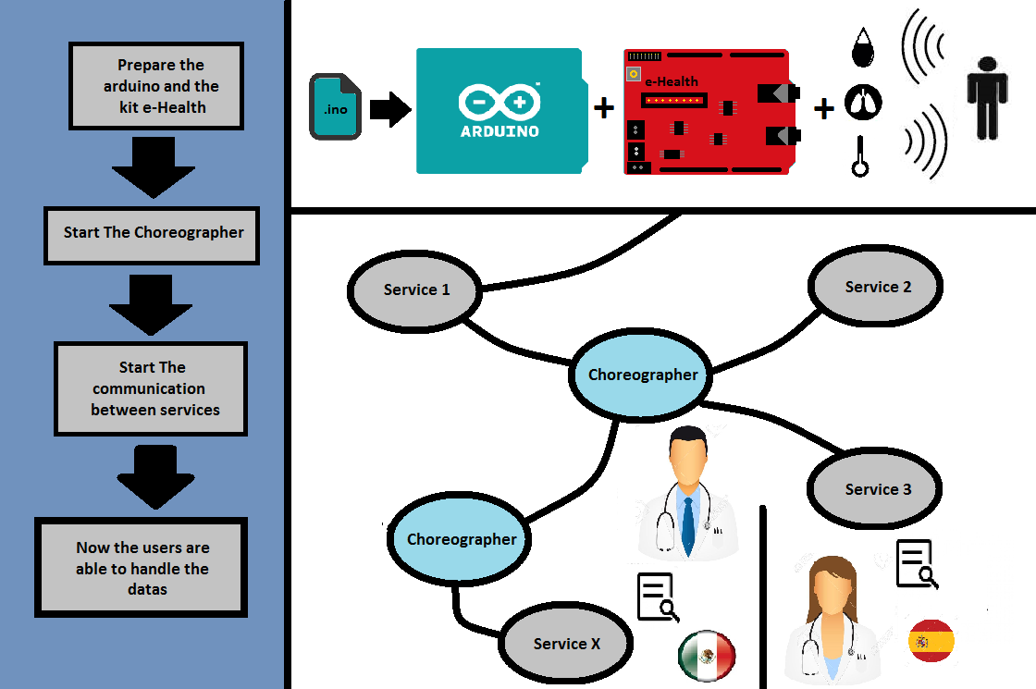
DEMONSTRATOR

Slide 7
PERSONAL CONCLUSION
I think that this project has a lot of potential as a helping tool for professionals in the Health area where the distance is a critical factor, it allows the distribution of information for patient monitoring.

